Slide 1

Madrid Training School
Digging for Gold: Knowledge Extraction From Text
This project has received funding from the European Union’s Horizon 2020 research and innovation programme under grant agreement No 101004984

Slide 2
Python for Digital Humanities

Slide 3
Popular Analytical Approaches to DH *guide to Programming for the Digital Humanities, Kokensparger, B.
Digital Archiving and Editing: Obtaining and making artifacts
Quantitative Analysis: stadistical methods
Network Analysis: connections between entities
Spatial Analisys: Analysis reference to its locations
Stylometry: classification in terms of style
Textual Analysis: measuring attributes of one or more texts
Topic Modelling: Discovering topics and determining relations
Visualization: displaying information
Notes:
Digitial humanities is a trending topic at this moment and and there is a special interest on this subject. We can summarize The popular approaches to DH in this 8 topics.
Contarlos
In this workshop we will go through some of this topics. So

Slide 4
Outcomes
Learn
Learn some about how to program in python (if you do not know anything about this language)
Use notebooks as useful tools for Digital Humanities researchers
How to create code for solve some of the previous topics.
Learn
Practice

Slide 5
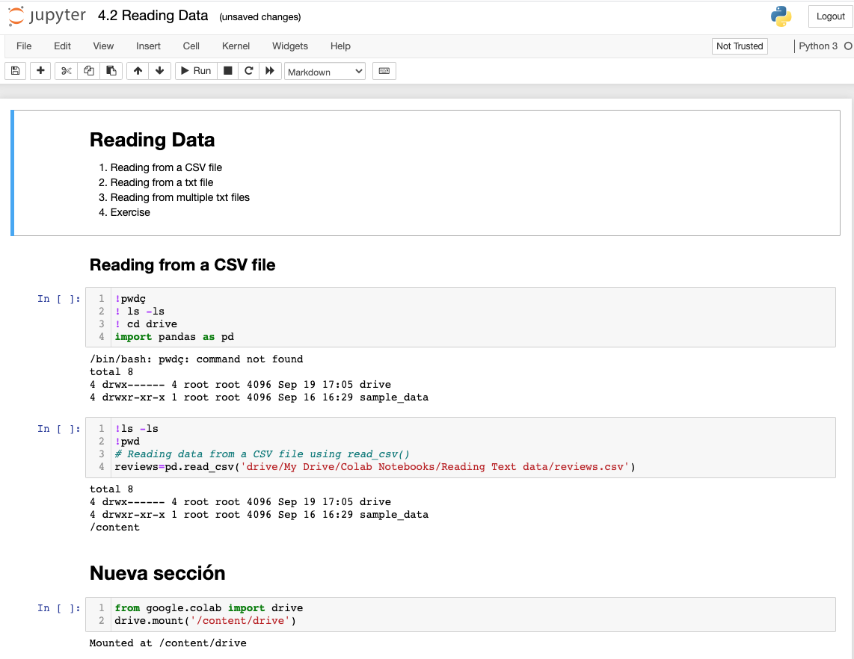
NOTEBOOK FRAMEWORKS
Definition: Jupyter Notebook (formerly IPython Notebooks) is a web-based interactive computational environment for creating Jupyter notebook document.
A Jupyter Notebook document is a JSON document, following a versioned schema, containing an ordered list of input/output cells which can contain:
code,
text (using Markdown),
mathematics,
plots and rich media
File usually ending with the ".ipynb" extension.

Slide 6
NOTEBOOK FRAMEWORKS
Installing
Local installation of Anaconda (Jupyter Notebook)
Using
Google Collaborate on your browser
https://colab.research.google.com/notebooks/intro.ipynb?hl=en
https://www.anaconda.com/ (download)

Slide 7
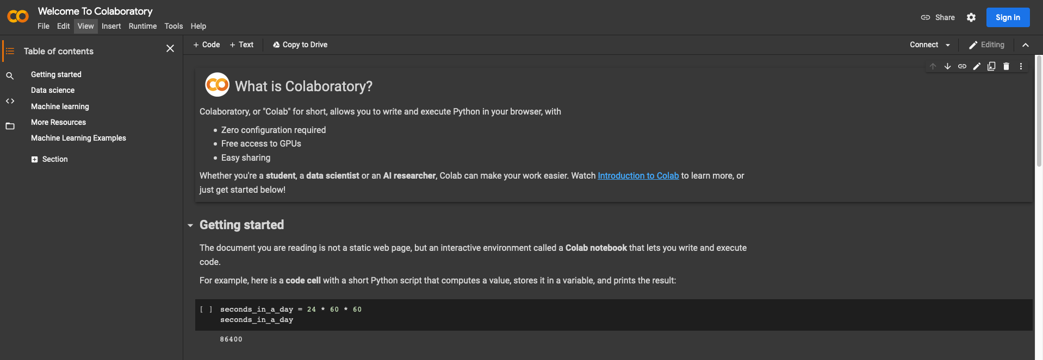
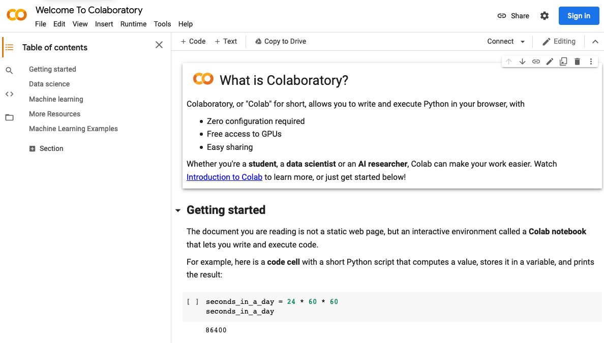
Google Collab

Slide 8
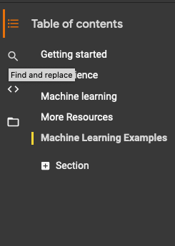
COLLAB MENU :help
Table of content
It is a help notebook with lot of links and information

Slide 9
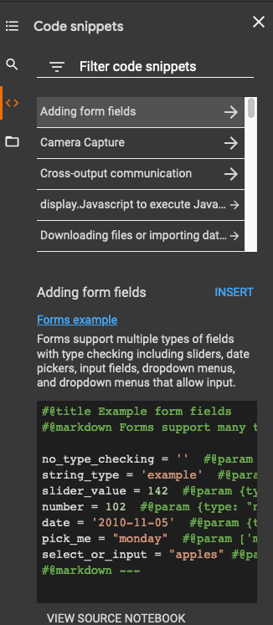
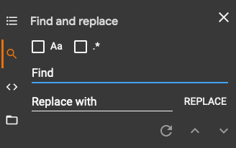
COLLAB MENU :BASICS and MORE HELP

Slide 10
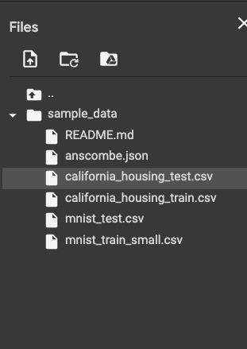
CoLLAB MENU: STORAGE
Upload a file. Caution !!
The Virtual Machine Hard disk
Your Google Drive.

Slide 11

COLLAB MENU: CLASSIC

Slide 12
JUPYTER NOTEBOOK
Same functionality as Collab ( it is the same thing)
You can install in your computer (Linux, Mac)
pip install jupyter
You can install Anaconda in your computer.(Windows, Linux,Mac)

Slide 13
Let´s Start Introduction to Python I
Comments
Variables
Constants
Print
Data Types
a) Strings
b) Numbers
c) Booleans

Slide 14
Introduction to Python II
Control Structures
Conditional
Loops
Functions

Slide 15





DATA CYCLE FOR DH FOR TEXT analyzing
Upload Text / Data
Clean Data
Extracting Features
Analyzing Features
Plotting data

Slide 16
LOAD TEXT
Reading Data
Obtaining data from Guttemberg project
Using NLTK for getting text
Reading from a CSV file
Reading from a txt file
Reading from multiple txt files
Exercise
Reading Excel files

Slide 17
CLEAN UP Data
We can use regular expressions
Allow us to look for patterns in the strings
Very useful URL to check regular expression
https://regex101.com/
Special functions that help us to clean up text

Slide 18
Let´s Start

Slide 19
Spacy
spaCy is a free, open-source library for advanced Natural Language Processing (NLP) in Python.
There other libraries:
Nltk: https://www.nltk.org/
Freeling http://nlp.lsi.upc.edu/freeling/node/1
CoreNLP https://stanfordnlp.github.io/CoreNLP/

Slide 20
Spacy functionalitIES
NAME | DESCRIPTION
Tokenization | Segmenting text into words, punctuations marks etc.
Part-of-speech (POS) Tagging | Assigning word types to tokens, like verb or noun.
Dependency Parsing | Assigning syntactic dependency labels, describing the relations between individual tokens, like subject or object.
Lemmatization | Assigning the base forms of words. For example, the lemma of “was” is “be”, and the lemma of “rats” is “rat”.
Sentence Boundary Detection (SBD) | Finding and segmenting individual sentences.
Named Entity Recognition (NER) | Labelling named “real-world” objects, like persons, companies or locations.
Entity Linking (EL) | Disambiguating textual entities to unique identifiers in a knowledge base.
Similarity | Comparing words, text spans and documents and how similar they are to each other.
Text Classification | Assigning categories or labels to a whole document, or parts of a document.
Rule-based Matching | Finding sequences of tokens based on their texts and linguistic annotations, similar to regular expressions.
Training | Updating and improving a statistical model’s predictions.
Serialization | Saving objects to files or byte strings.

Slide 21
Spacy
Some of spaCy’s features work independently,
others require trained pipelines to be load :Stadistical language models
Calling the nlp object on a string of text will return a processed Doc with all the information needed.
https://spacy.io/usage/spacy-101

Slide 22
Spacy ARchitecture
PIPELINE

Slide 23
Spacy pipeline

Slide 24
Tokenization
Tokenization is the task of splitting a text into meaningful segments, called tokens
First text.Split(‘’)
Check tokenizer excception rules
Split off a prefix,sffix or infix if it is posible.

Slide 25
Modify Tokenization Rules
from spacy.symbols import ORTH
doc = nlp("gimme that") # phrase to tokenize
print([w.text for w in doc]) # ['gimme', 'that']
# Add special case rule
special_case = [{ORTH: "gim"}, {ORTH: "me"}]
nlp.tokenizer.add_special_case("gimme", special_case)
# Check new tokenization
print([w.text for w in nlp("gimme that")]) # ['gim', 'me', 'that']

Slide 26
THANK YOU
sros@scc.uned.es

